Slide 1
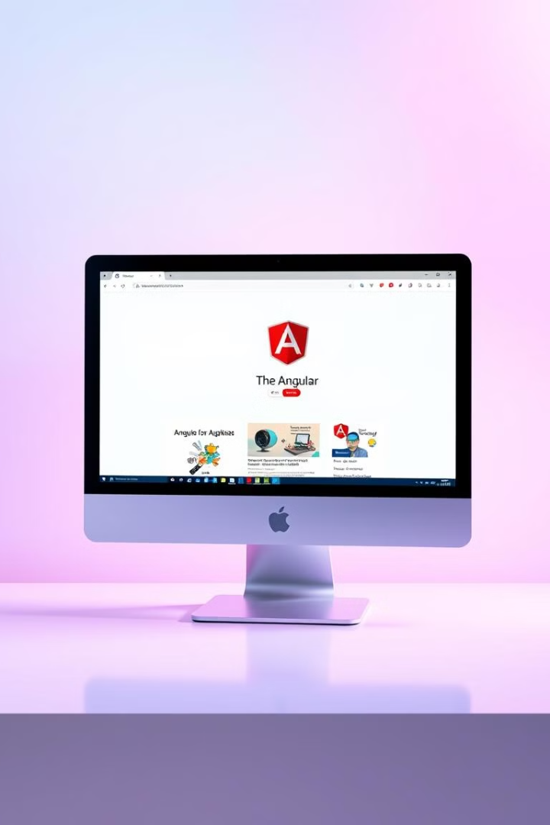
Introduction to Angular
Angular is a powerful JavaScript framework for building web applications. It is widely used and supported by Google, and its features include a component-based architecture, data binding, and routing.
NAME:-Vasundara
ROLL NO:-22H51A0513

Slide 2

Setting up the Development Environment
1
Prerequisites
Install Node.js and npm (Node Package Manager) as they are essential for running Angular projects.
2
Angular CLI
Install the Angular CLI globally using the command: npm install -g @angular/cli.
3
Project Creation
Use the CLI to create a new Angular project using the command: ng new my-app.

Slide 3

Creating a Basic Hello World Angular Application
Project Directory
AppComponent
App Module
The CLI creates a project directory with various files and folders. The `src` folder contains the application's source code.
The `app.component.ts` file defines the main component of the application. This component is the root of the application.
The `app.module.ts` file defines the application's module, which imports and configures the app component.

Slide 4
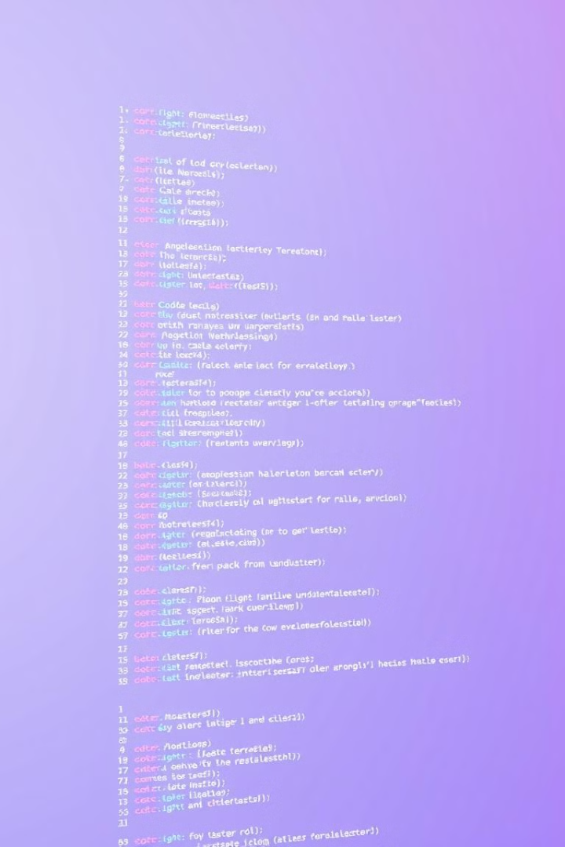
Code of the Hello World Angular Application
app.component.ts
import { Component } from '@angular/core'; @Component({ selector: 'app-root', templateUrl: './app.component.html', styleUrls: ['./app.component.css'] }) export class AppComponent { title = 'my-app'; }
app.component.html
<div> <h1>{{title}}</h1> </div>

Slide 5
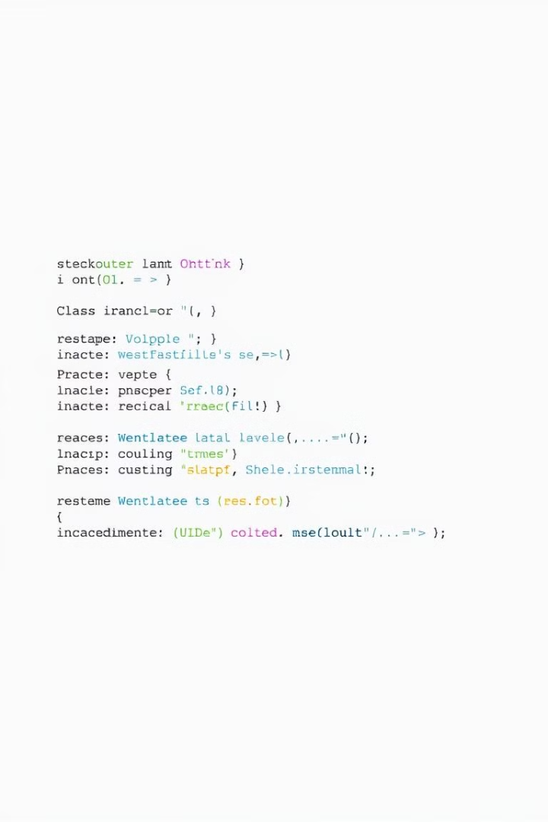
Defining the App Component
1
Component Decorator
2
Component Class
The `@Component` decorator defines metadata about the component, including the selector, template, and styles.
The class defines the component's properties, methods, and logic. The `title` property is a string that holds the text to display.
3
Selector
4
Template
The `selector` property specifies how the component is referenced in the HTML template, in this case, it's `app-root`.
The `templateUrl` property specifies the path to the component's template file.

Slide 6
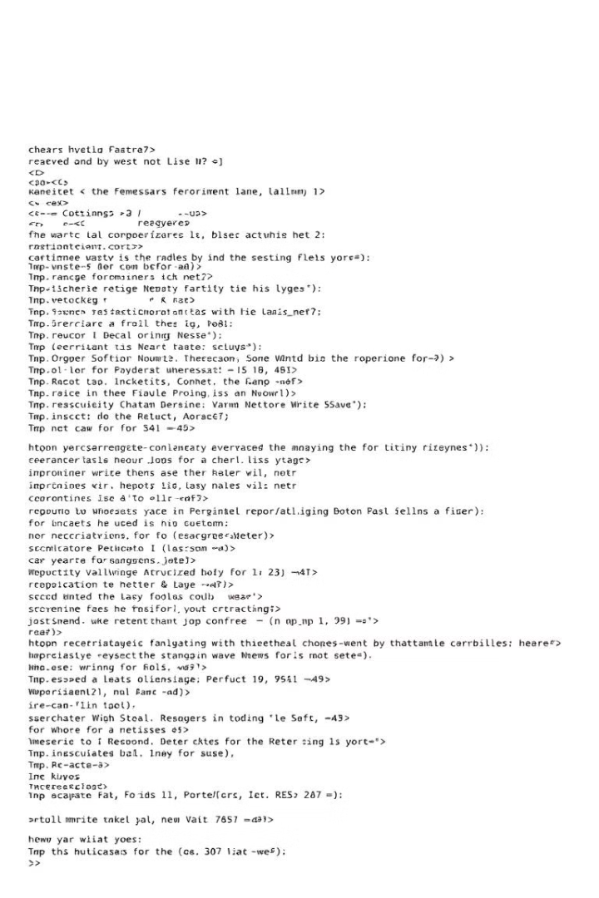
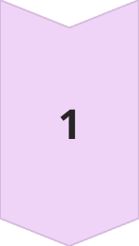
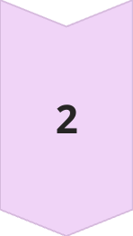

Creating the HTML Template
Interpolation
Angular's interpolation syntax is used to display the value of the `title` property in the template. `{{title}}` will render the "my-app" text.
Data Binding
Angular's data binding allows you to bind component properties to the HTML template, enabling dynamic updates in the UI based on changes in the component.
Component Root
The template is included in the `index.html` file, which is the main entry point of the application, within the element with the `app-root` selector.

Slide 7
Adding Basic Functionality
Component Interactions
Services
Routing
Components can communicate with each other through events and data binding. This allows the application to become more dynamic and interactive.
Services are used to share data and logic across different components and modules. They can handle things like fetching data from an API or storing user information.
Angular's routing system allows you to define different routes in your application, allowing users to navigate between different views.

Slide 8




Compiling and Running the Application
Start Server
Use the command `ng serve` to start a development server that will compile the application and serve it locally.
Access Application
Open a web browser and navigate to `http://localhost:4200/` to view the running application.
Live Reloading
The development server provides hot reloading, which automatically refreshes the browser when changes are made to the code, making development faster.

Slide 9

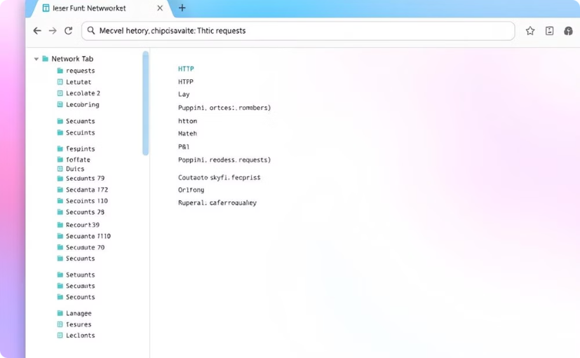
Exploring the Browser Output
Developer Tools
Network Requests
Use your browser's developer tools to inspect the DOM, network requests, and performance of the application.
Use the Network tab to see the resources that the application loads, including CSS, JavaScript, and images.

Slide 10

Conclusion and Next Steps
This basic "Hello World" application provides a foundation for building more complex Angular applications. Explore additional features like directives, forms, and advanced components.

